Slide 1
Personal_Finances_Age18-34 Part2
File created on: 1/15/2025 5:56:57 PM

Slide 2
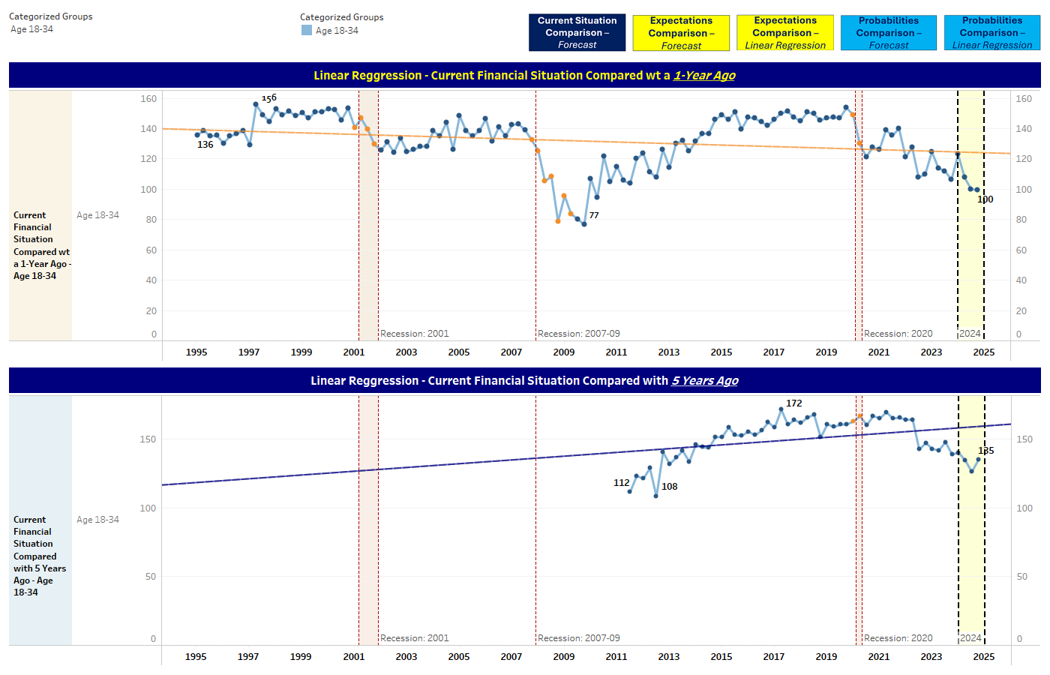

Slide 4
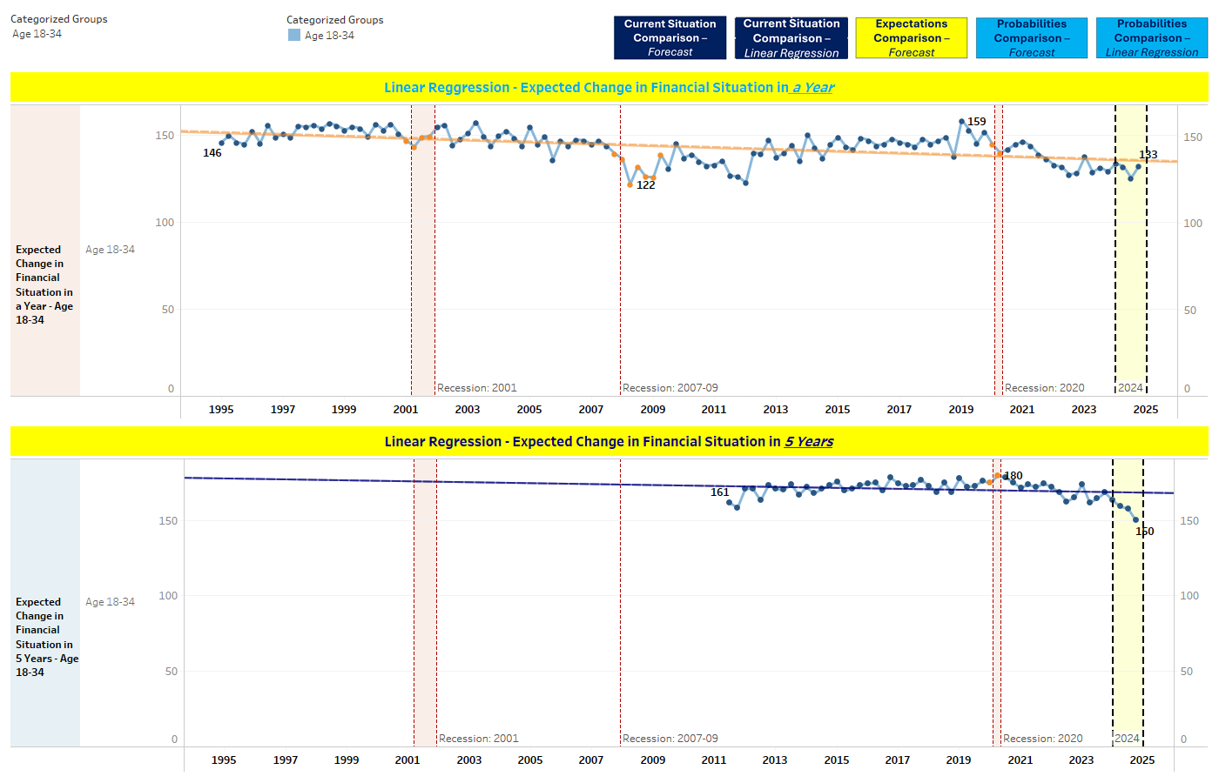

Slide 5
